Slide 1

Shell Programming Lecture # 8
Dr. Muhammad Bilal Qureshi
m.qureshi@centralasian.uz
Central Asian University, Tashkent, Uzbekistan

Slide 2
Source
Textbook:
Beginning Linux Programming 4th Edition by Neil Matthew

Slide 3
Contents
Commands
find and grep
Regular expressions
Command execution
Arithmetic expansion and parameter expansion
Here Documents
Debugging Scripts

Slide 4
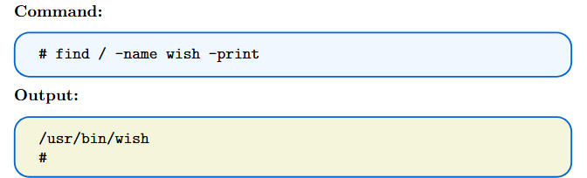
find
The find command is extremely useful for searching files.
It accepts options, tests, and action-type arguments.
The result of one argument can affect the processing of subsequent arguments.
Running the command as root ensures full permissions to search the entire machine.
The command may take a long time to execute, especially when accessing network drives.

Slide 5
Cont()..
If we specify -mount, to ignore search in mounted directories:
# find / -mount -name wish –print
/usr/bin/wish
#
The full syntax for the find command is:
find [path] [options] [tests] [actions]
The path part is nice and easy: We can use either an absolute path, such as /bin, or a relative path, such as .. If we need to, we can also specify multiple paths, for example find /var /home
find /bin -name “*.txt” Searches for files with the extension ".txt" starting from the /bin directory.
find .. -name “*.txt” Searches for files with the extension ".txt" starting from the parent directory of the current directory.

Slide 6
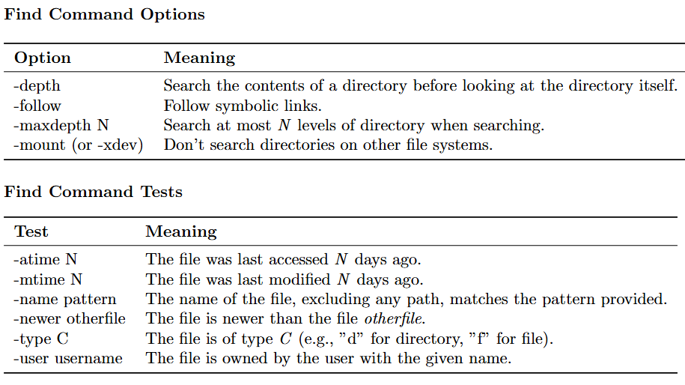
Cont()..
There are many options few of them are shown here, the result of the test returns true or false.

Slide 7
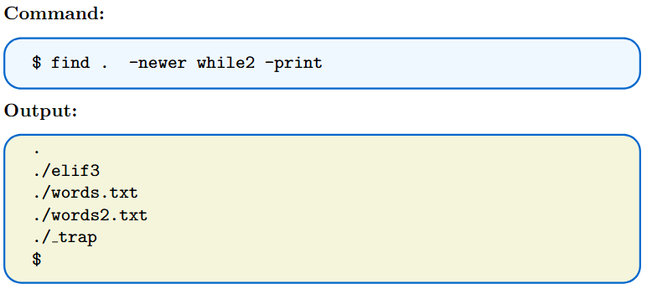
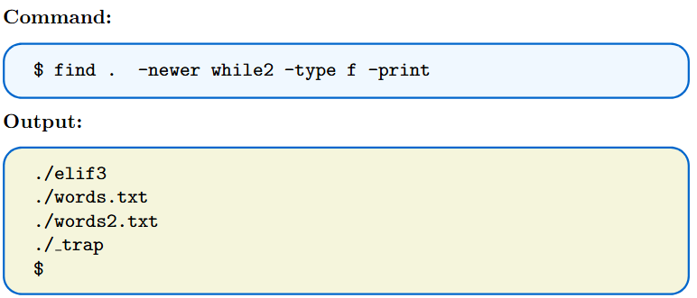
Cont()..
Let’s try searching in the current directory for files modified more recently than the file while2:
That looks good, except that we also find the current directory, which we didn’t want; we were interested only in regular files. So, we add an additional test, -type f:

Slide 8
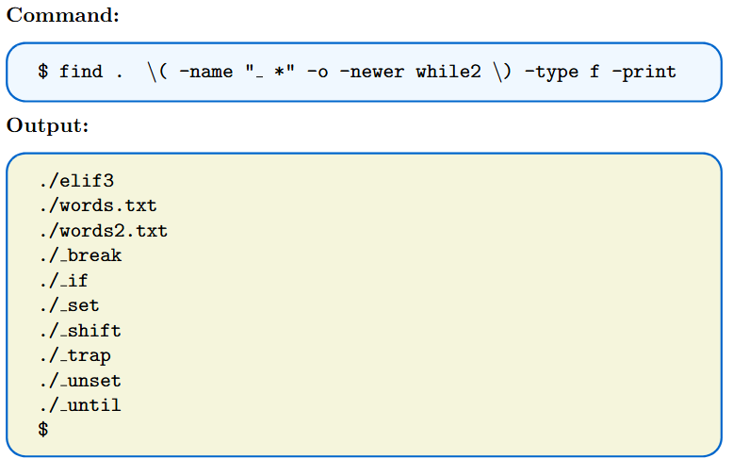
Cont ()...
Multiple test using –o or –or
Finding files start with underscore or newer than while2, but must be regular file.
\ is used to escape the parenthesis in shell as it is used to combine commands.

Slide 9
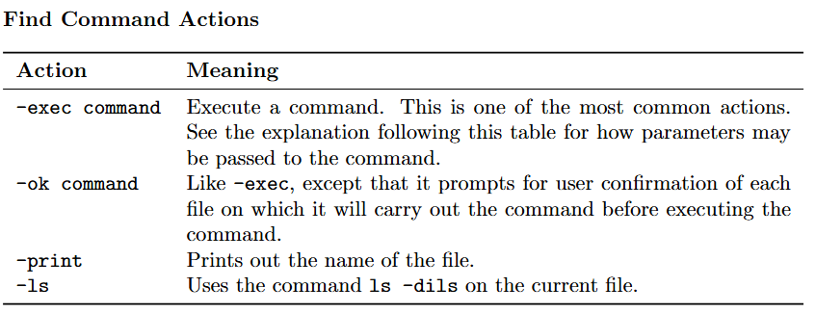
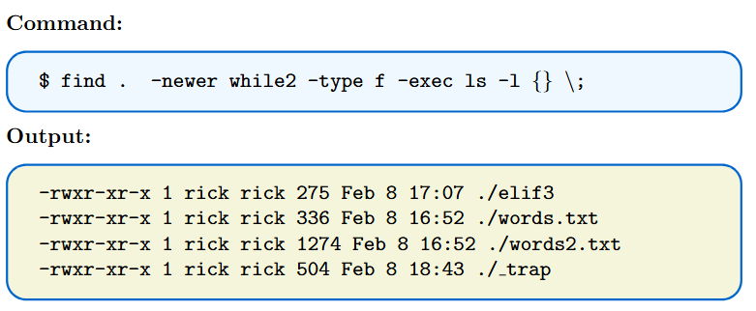
Cont ()..
let’s look at the actions we can perform when we find a file matching our specification.
Again, this is just a list of the most common actions; the manual page has the full set.
Notes:
The ls -dils command is used to list directory entries instead of their content, displaying the inode information for each entry. Here's what each option does:
-d: List directories themselves, not their contents.
-i: Include the inode number for each file or directory.
-l: Use a long listing format, displaying additional information such as permissions, owner, group, size, and modification date.
The -exec and -ok commands take subsequent parameters on the line as part of their parameters, until terminated with a \; sequence. The magic string {} is a special type of parameter to an -exec or -ok command and is replaced with the full path to the current file.

Slide 10
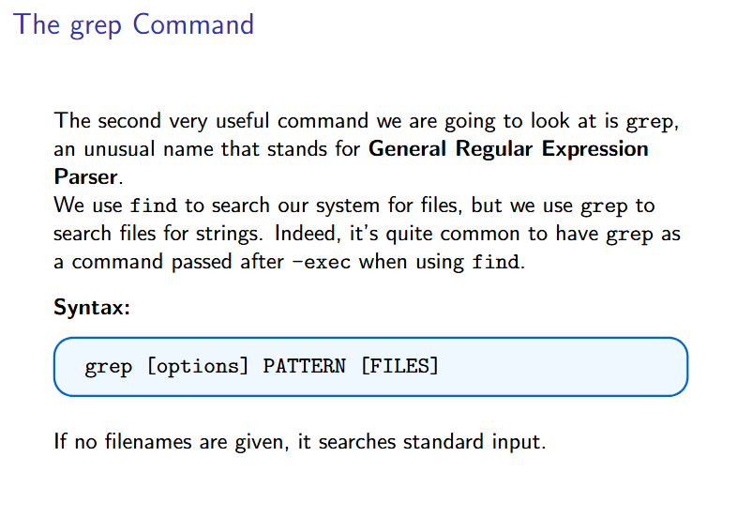

Slide 11
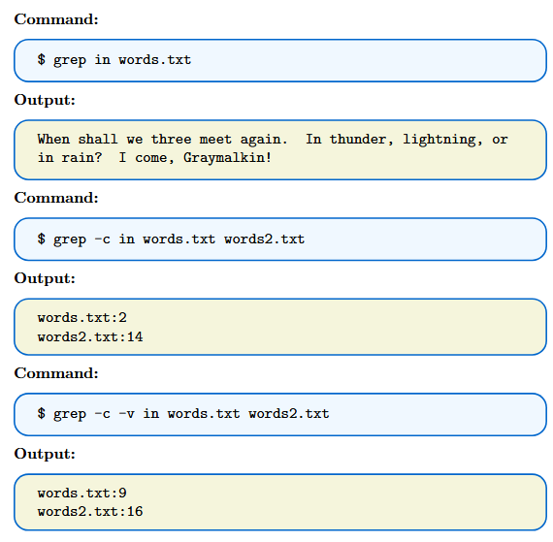
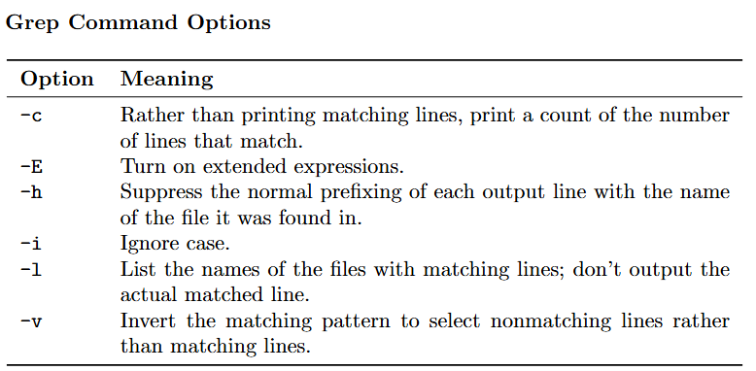
Cont()..
Let’s start by looking at the principal options to grep. Again, we will list only the principal options here; see the manual pages for the full list.
Notes:
Cat aka concatenate the contents of one or more file
grep -E 'apple|orange' fruits.txt
Support for alternation (|) - matches one of a choice of alternatives.
Support for grouping () - groups together multiple tokens into a single unit.
Support for quantifiers (+, ?, {}) - specifies how many instances of a token should be matched.
Support for more advanced character classes and metacharacters.

Slide 12
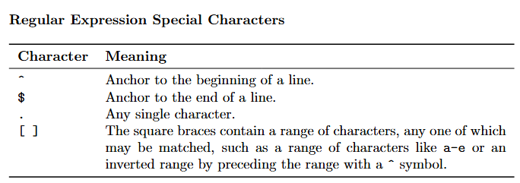
Regular Expression grep command
As we have seen, the basic usage of grep is very easy to master. Now it’s time to look at the basics of regular expressions, which allow you to do more sophisticated matching.
During the use of regular expressions, certain characters are processed in a special way. The most frequently used are as follows:
If you want to use any of these characters as “normal” characters, precede them with a \. So, if you wanted to look for a literal “$” character, you would simply use \$.
Notes:
Regular expressions are a sequence of characters that define a search pattern, used for string matching and manipulation.

Slide 13
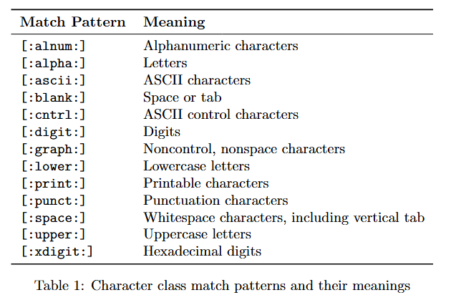
Cont()..
There are also some useful special match patterns that can be used in square braces:
Notes:
Hello123
45678
Welcome!
9876
Test123Test
grep '^[[:digit:]]\+$' data.txt

Slide 14
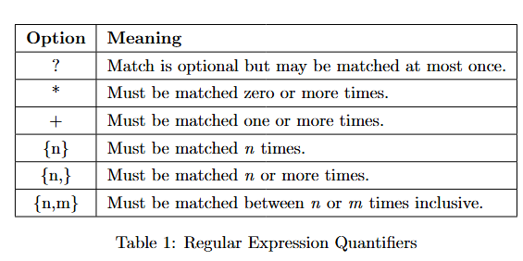
Cont()…
When the -E option is specified for extended matching, additional characters may be used to control the completion of matching.
In grep, these characters must be preceded by a backslash (\) to be interpreted correctly.
The -E option enables extended regular expressions, allowing for more complex pattern matching.
Notes:
-E (Extended Regular Expressions)Enables extended regex, allowing ?, +, |, and () without needing \
grep 'colou\?r' words.txt

Slide 15
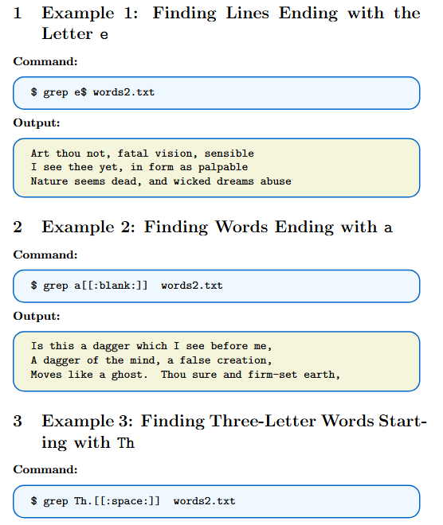
Examples

Slide 16
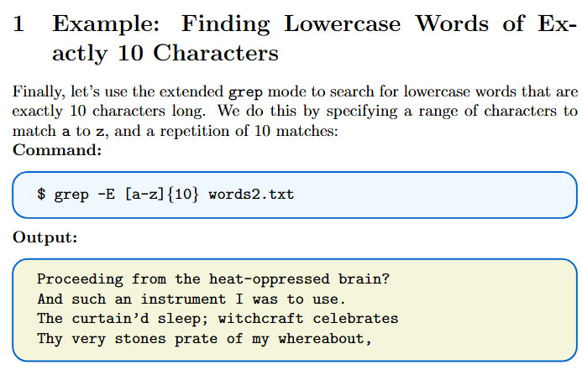
Example

Slide 17
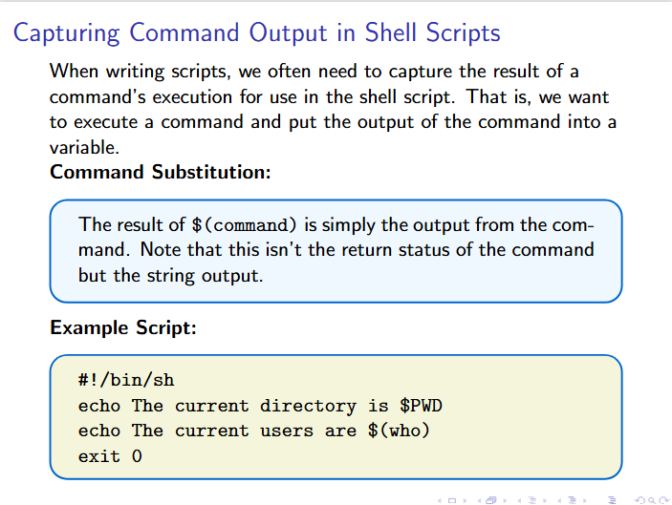
Command Execution

Slide 18
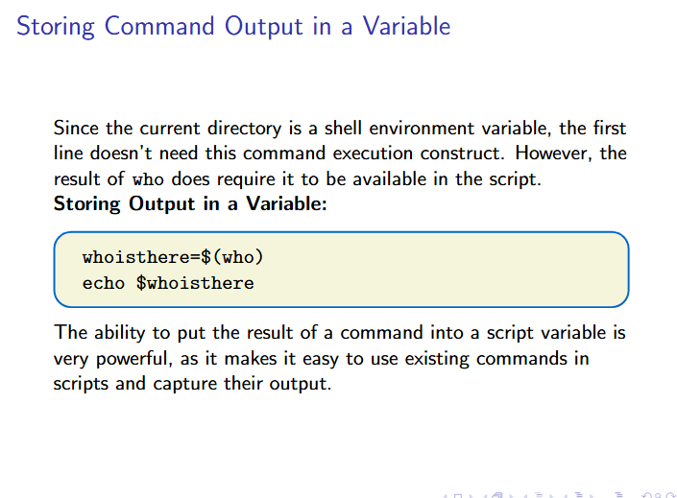
Cont()..

Slide 19
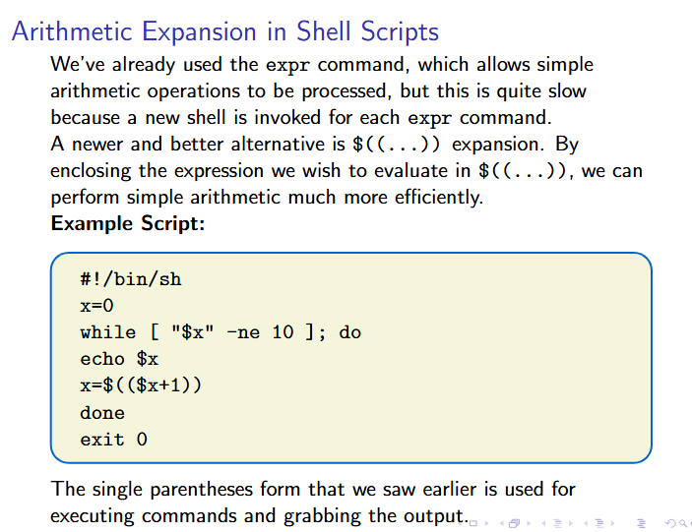
Arithmetic Expansion

Slide 20
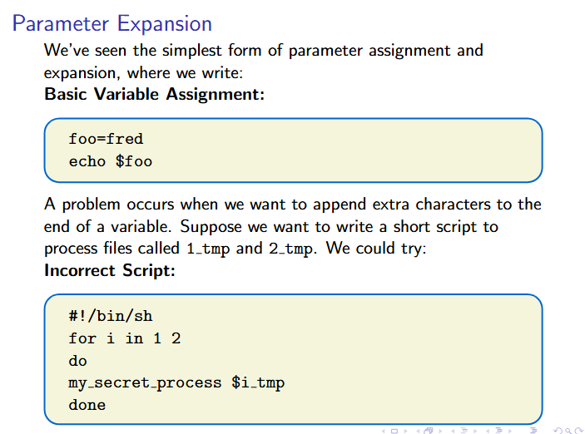
Parameter Expansion

Slide 21
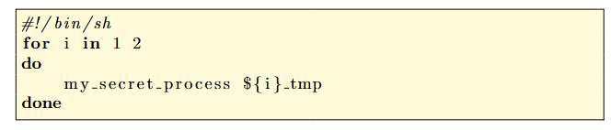
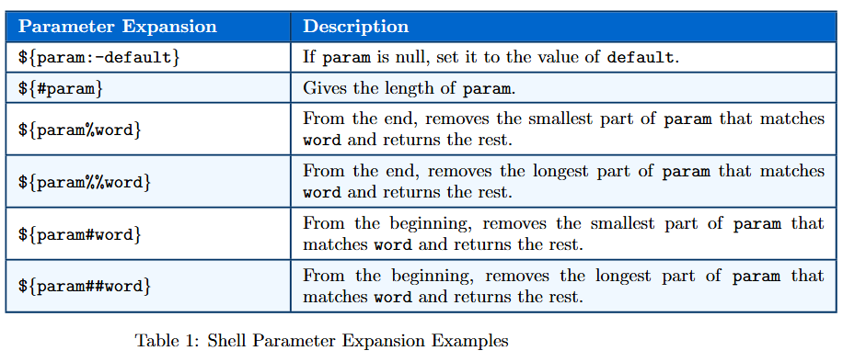
Cont()..

Slide 22
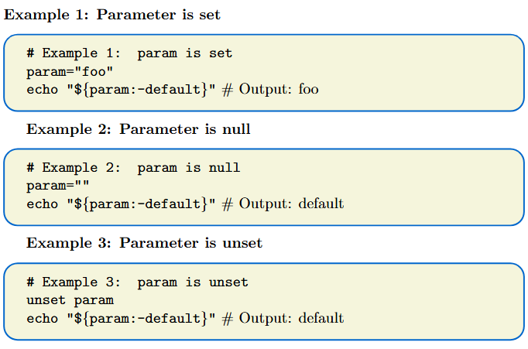
Examples

Slide 23
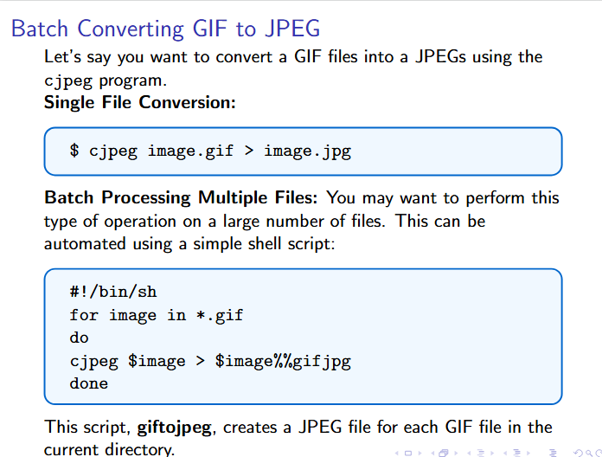
Example
Notes:
Correction ${image%%gif}jpg

Slide 24
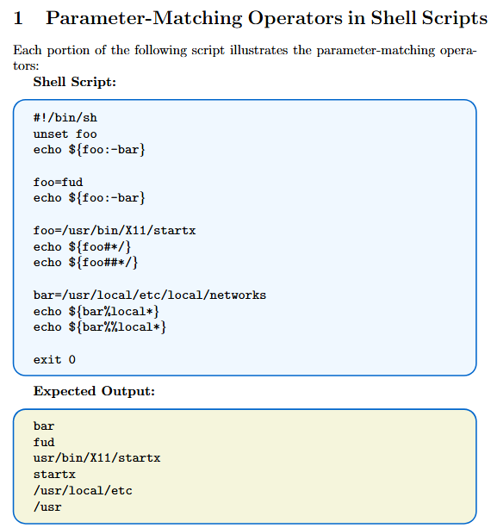
Example

Slide 25
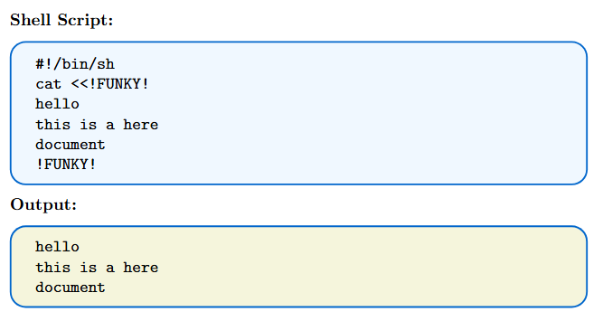
Here document
A here document allows passing input to a command from a shell script.
It allows the command to execute as though reading from a file or keyboard, but the input comes from the script itself.
A here document starts with the << symbol, which is the shell’s label redirector.
The << symbol forces the command input to be taken from the here document.
A marker is used at the end of the here document to tell the shell where it ends.

Slide 26
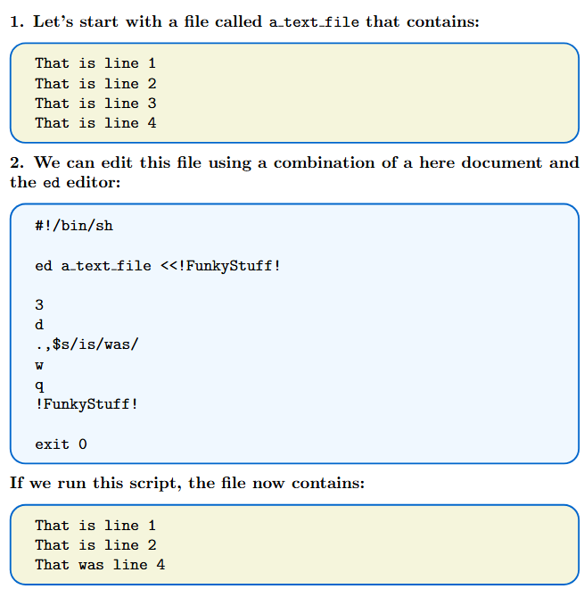
Cont()..
To process multiple lines in a file in a predetermined way, we can use the ed line editor.
The ed editor can be fed commands using a here document in a shell script.
Notes:
.,\

Slide 27
Debugging
Debugging shell scripts is usually quite easy, but there are no specific tools to help.
When an error occurs, the shell will normally print out the line number of the line containing the error.
If the error isn’t immediately apparent, you can add some extra echo statements to display the contents of variables and test code fragments by simply typing them into the shell interactively.
Since scripts are interpreted, there’s no compilation overhead in modifying and retrying a script.
The main way to trace more complicated errors is to set various shell options. To do this, you can either use command-line options after invoking the shell or use the set command. The following table summarize the options:

Slide 28
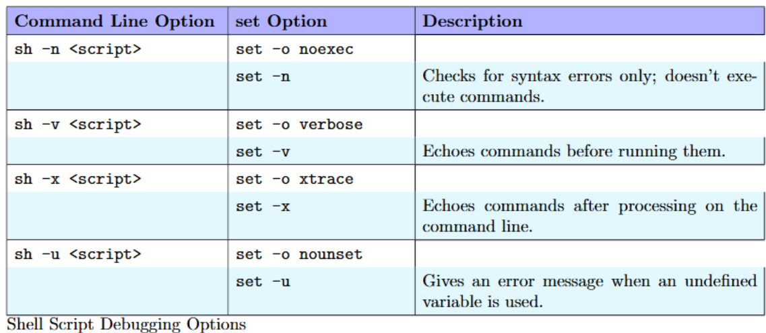
Debugging Options
You can set the set option flags on, using -o, and off, using +o, and likewise for the abbreviated versions. You can achieve a simple execution trace by using the xtrace option. For an initial check, you can use the command-line option, but for finer debugging, you can put the xtrace flags (setting an execution trace on and off) inside the script around the problem code. The execution trace causes the shell to print each line in the script, with variables expanded.

Slide 29
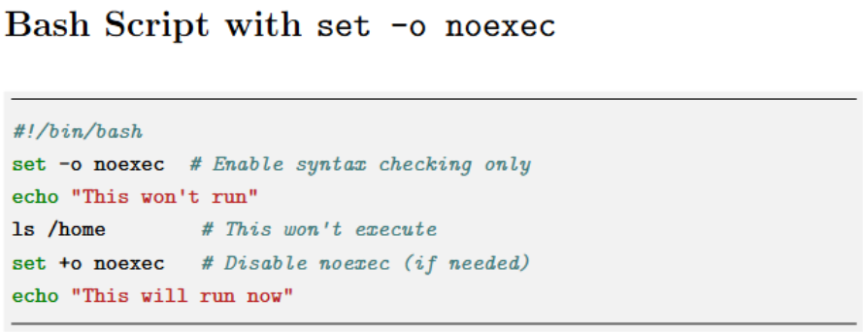
Cont()…
Feature | sh -n scriptname | set -o noexec
Scope | Affects only the specific command execution | Affects the script once set inside
Usage | Run from the command line before execution | Used inside the script to prevent execution
Effect | Entire script is checked and then exits | Script is read, checked, but does not execute
Toggle-able? | No, it’s a one-time check | Yes, can be disabled with set +o noexec

Slide 30



Using xtrace for Debugging
Turning xtrace On and Off:
Customizing xtrace Output:
By default, traced commands are prefixed with ‘+‘. You can change this by setting the PS4 shell variable
Tracing Script Exit:
To capture script exit information, trap the EXIT signal:
Notes:
#!/bin/bash
trap 'echo exiting: critical variable = $critical_Variable' EXIT
critical_Variable="System Failure Detected"
echo "Running some commands..."
sleep 2 # Simulating some process
# Exiting the script
exit 0
#!/bin/bash
trap 'echo "Error detected: critical variable = $critical_Variable"' ERR
critical_Variable="System Failure Detected"
echo "Running some commands..."
sleep 2
# Simulating an error
ls nonexistentfile # This command fails and triggers the trap
exit 0
#!/bin/bash
trap 'if [[ $? -ne 0 ]]; then echo "exiting: critical variable = $critical_Variable"; fi' EXIT
critical_Variable="System Failure Detected"
echo "Running some commands..."
sleep 2 # Simulating some process
# Exiting normally
exit 0

Slide 31
Thank You
Questions?

